Slide 1
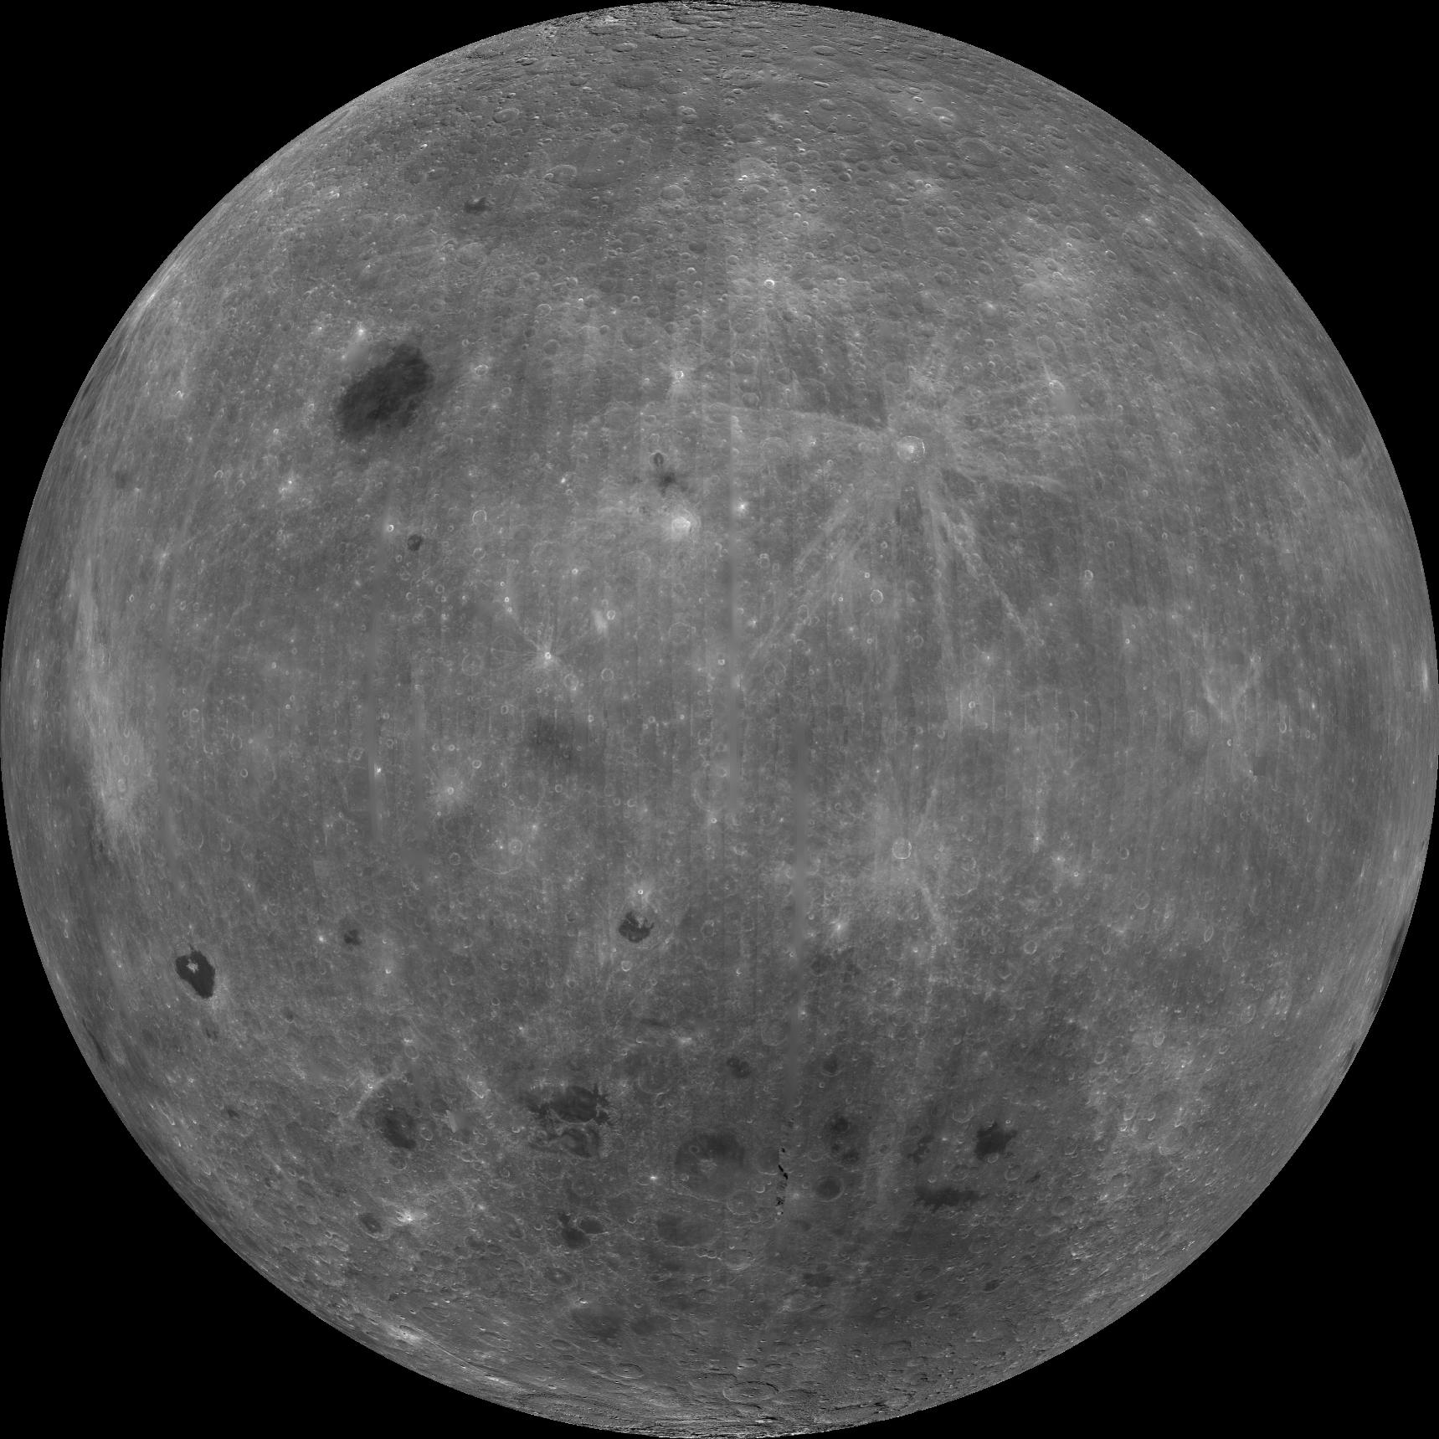
Austin High School
ESTACA
Decatur High School
Radio Astronomy on the Moon
Alabama A&M
College of Charleston
UAHuntsville

